Slide 1
Professions

Slide 2
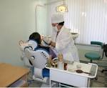
An operator
A doctor
A dentist
A secretary

Slide 3
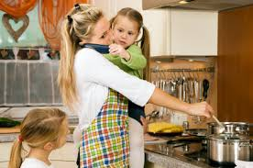
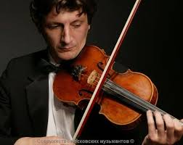
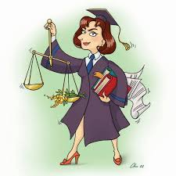
A housewife a musician
A bank manager
A lawyer

Slide 4
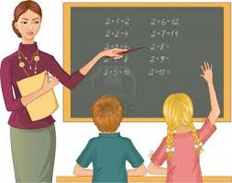
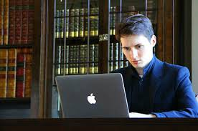
A teacher a driver
A computer
Programmer
A pilot

Slide 5
Is it a teacher?

Slide 6
Is it a doctor?

Slide 7
Is it a dentist?

Slide 8
A teacher | works in a school.
A writer | writes books.
A doctor | helps people.
A vet (veterinarian) | looks after animals.
A singer | sings song and play music.
A farmer | works on a farm.
An actor\actress | acts in plays\films.
A pilot | flies a plane.
A reporter | makes reports.
A sportsman | plays sports.
A police officer | wears uniform.

Slide 9
7. Correct the sentences. 1. Doctors teach children 2. A pilot drives a car. 3. A farmer works on a farm. 4. Teachers work at school. 5. A fireman brings letters. 6. A programmer fights fires. 7. Dancers work in the hospital.

