Slide 1
The Degrees of Comparison of Adjectives

Slide 2
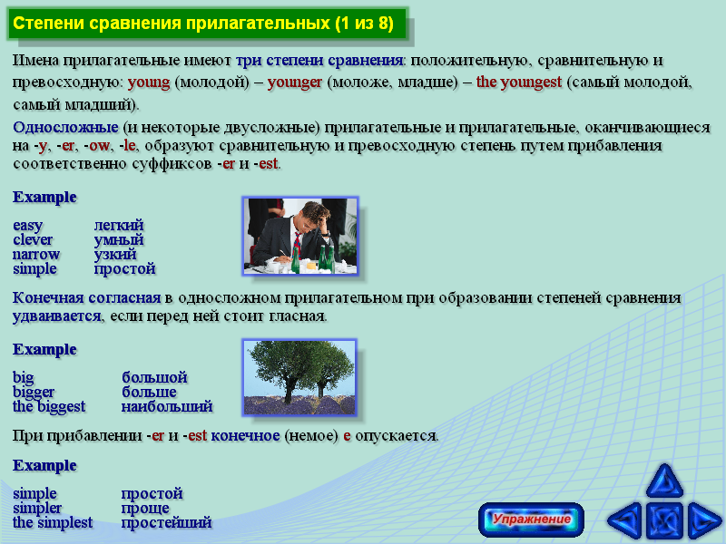

Slide 3
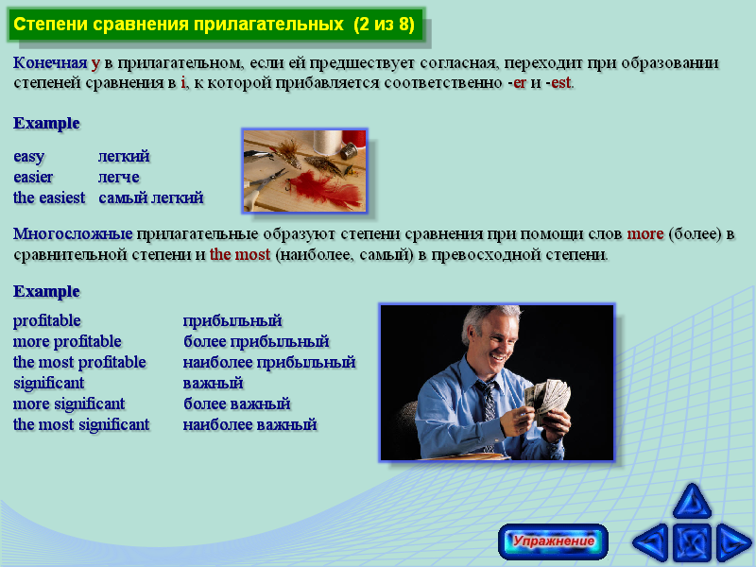

Slide 4
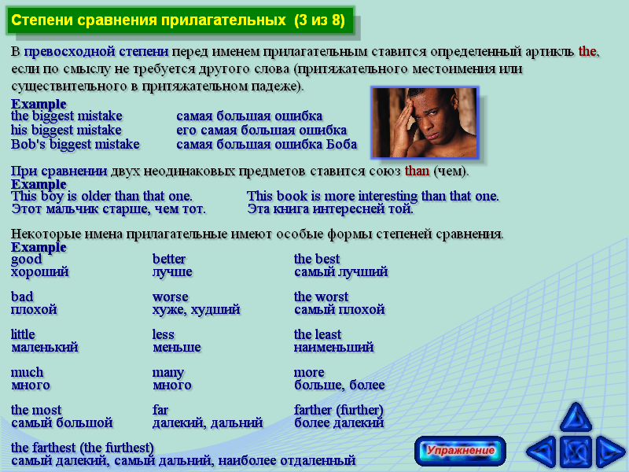

Slide 5
Superlative degree of comparison
Exercise1.
Here are some interesting and amusing facts from The Guinness book of World Records. Write the correct form of superlative in the spaces provided.
_______________ (large) cucumber weighed 66lb.
_______________ (popular) tourist attraction in the United States id Disneyworld.
_______________ (successful) songwriters are Paul McCartney and late John Lennon.
_______________ (heavy) baby at birth was a boy of 22 lbs. 8 oz. He was born in Italy in 1995.
_______________ (fat) person was a man in New York City. He weighed almost 1200 lbs. In 1987, he got stuck in his bedroom doorway and had to be rescued by firemen.
_______________ (prolific) painter was Pablo Picasso (1881-1973)/ He produced about 13,500 paintings, 34,000 book illustrations, and 300 sculptures.
_______________ (long) attack of hiccups lasted 67 years.
_______________ (big) omelet was made of 54/763 eggs with 531 lbs. Of cheese in Las Vegas, Nevada in 1986.

Slide 6
Read and remember haw to use these adjectives in the sentences
1.This book is better that that one.
2. Today the weather is worse that it was yesterday.
3. The worst weather in our city is usually in February.
4. The books for chemistry cost more than the books for history. The books for English are the most expensive.

