Slide 1
Present Perfect
Continuous

Slide 2
Present Perfect Continuous: описание длительного действия, которое началось в прошлом и все еще продолжается или только что закончилось.
На русский язык в большинстве случаев переводится глаголом в настоящем времени.

Slide 3
Образование:
Have
has
+ been + Ving

Slide 4
We have been learning English for six month.
Мы учим английский шесть месяцев.
How long has Ann been waiting for?
Сколько времени ждет Анна?

Slide 5
For – в течение
Since – с, с тех пор как
All day (all my life,... ) – весь день ( всю жизнь, ... )
Recently - недавно
Lately – в последнее время
For a long time - долго

Slide 6
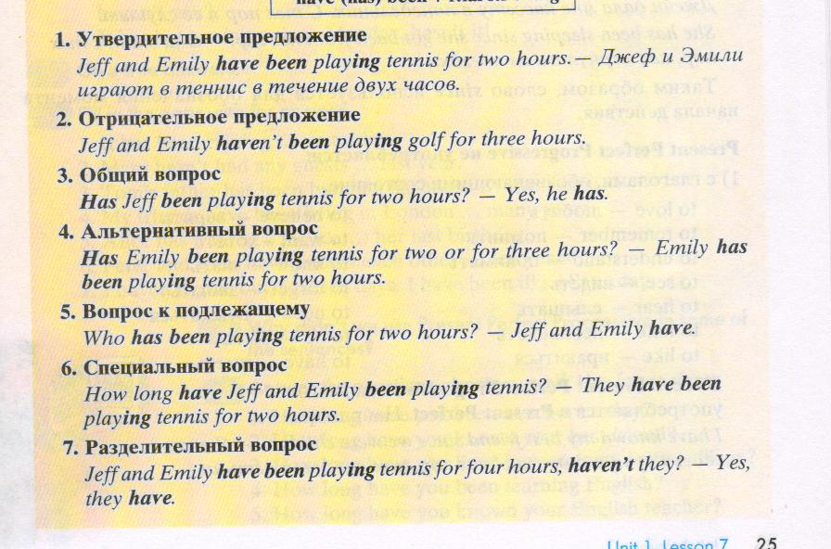

Slide 7
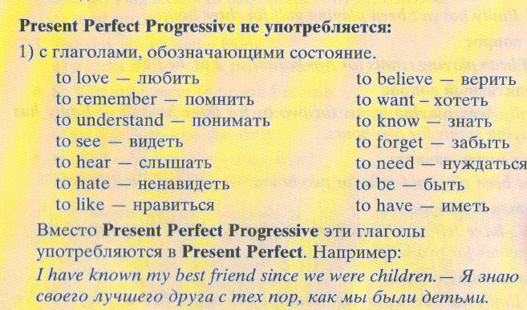

Slide 8
Раскрой скобки, используя Present Perfect Progressive:
I ( to look) for my book for an hour.
They ( to quarrel) for such a long time.
How long they ( to practice) today?
It’s ( to rain) all day.
He ( not/to feel) well lately.
She ( to live) here since childhood.
We ( to drive) for about two hours.

Slide 9
Исправь ошибки:
We to have been learning Spanish for six days.
Peter have been running the company for ten years.
You’ve making good progress in your English lately.
I’ve been have a lot of trouble with this equipment.
We has make some changes in the project.
They has been trying to settle the matter by ourselves.
Mary have to look for some exhibition grounds since last month.
Have been John using your car?

Slide 10
Vera did athletics last year.
Vera has been doing athletics since last year.
My sister used this shampoo two years ago.
He often skipped breakfast when he was a student.
My aunt ate much chocolate in her childhood.
Nick cleaned his teeth with a new toothpaste yesterday.
I prepared for the English exam last week.
They went to the swimming pool last month.

Slide 11
1. My grandfather (to work) in the garden since he retired.
2. I (to use) this cream since I discovered it.
3. She (to sell) fruit and vegetables for five years.
4. The factory (to produce) these trainers for two years.
5. My mum (to eat) low-calorie foods for six months.
6. My sister (to do) aerobics since last year.
7. I (not to eat) a fried meal since I began to follow a diet.
8. Mary (to use) this toothpaste for a long time.
9. His grandmother (not to smoke) since he visited his heart doctor.
10. She (not to drink) strong tea for many years.
Раскрой скобки, используя Present Perfect Progressive:

