Slide 1
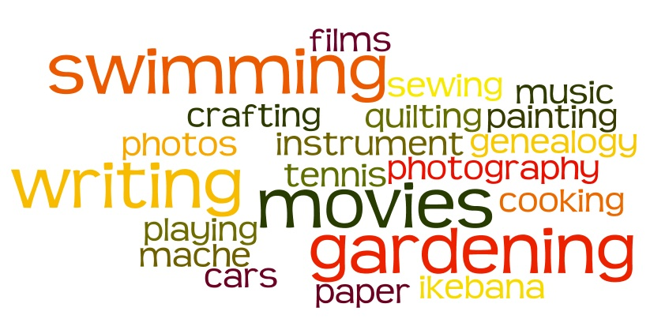
Hobbies
www.interactive-english.ru

Slide 2


What is a hobby?
A hobby is something you like to do when you are free. Hobbies make your life more interesting.

Slide 3
What is a hobby?
All hobbies can be divided into 4 main groups

Slide 4


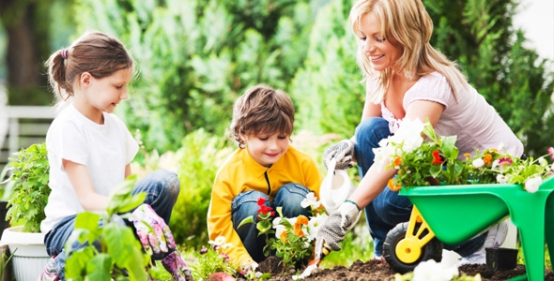
Doing things
Reading books
Gardening
Growing flowers
Surfing the net
Listening to music
Dancing
Drawing
Fitness
www.interactive-english.ru

Slide 5
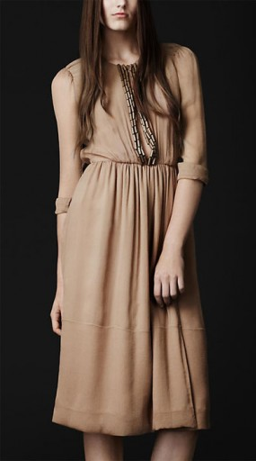
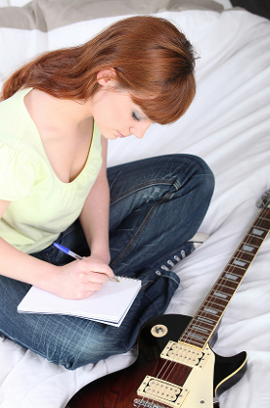

Making things
Composing music
Writing stories
Designing clothes
Making car models

Slide 6
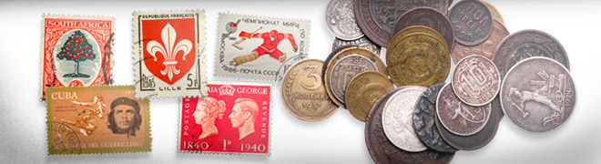
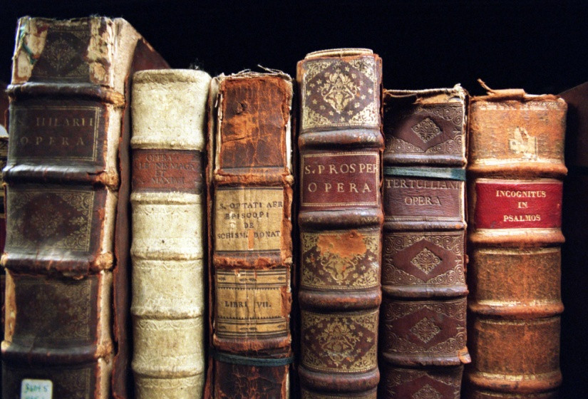
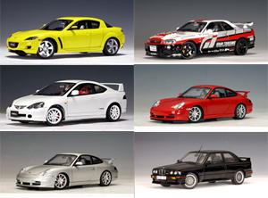
Collecting things
Stamps, coins
Books, CDs
Videos, toys
Posters, postcards
Pens, pencils

Slide 7


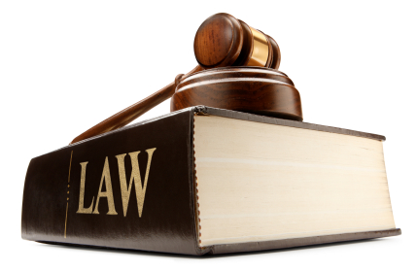
Learning things
Foreign languages
The history of…
The problems of…
Studying law
www.interactive-english.ru

Slide 8
Interesting facts
5 Celebrity Hobbies That Might Surprise You

Slide 9
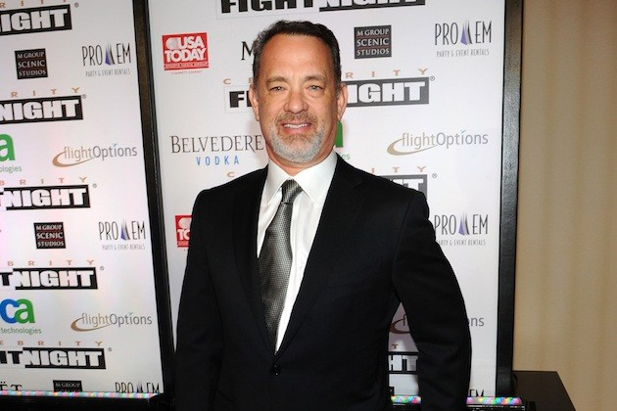
1. Tom Hanks collects typewriters
Yes, Tom Hanks is a fan of typewriters. No, he doesn’t hoard computer keyboards, but vintage, manual typewriters. Most of the typewriters Hanks has are still in working condition.

Slide 10
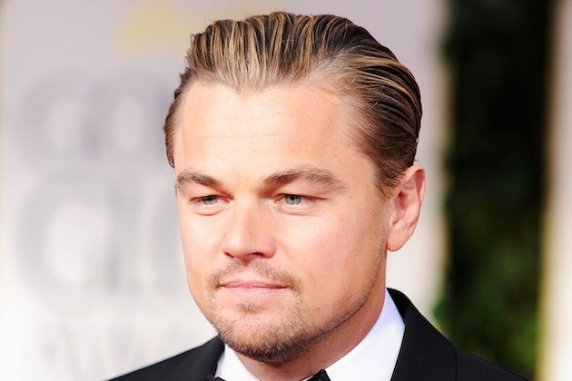
2. Leonardo DiCaprio geeks out over action figures
Mr. DiCaprio has a great love of tiny plastic action figures. Considering the amount of money his films have made, he might become an action figure himself one day. His collection includes 'Star Wars' and 'He-Man' action figures, as well as other vintage toys.

Slide 11

3. Will Smith and Tom Cruise practice fencing
Will Smith is a huge fan of swordplay. The Hollywood actor took up fencing when his good friend Tom Cruise introduced him to the sport. David Beckham has also gotten into the act. When time allows, the three men get together and fence in a practice room at Tom’s house.

Slide 12
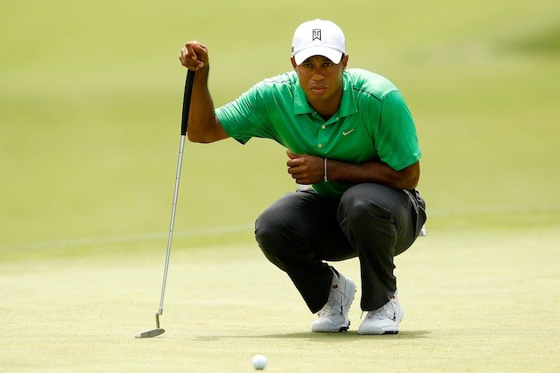
4. Tiger Woods goes spearfishing
How does a world famous golf pro relax in his free time and get away from it all? Why, he goes spearfishing, of course. If his aim with a spear is as good as his aim with a golf club, then whatever fish he happens to set his sights on doesn’t stand a chance.

Slide 13
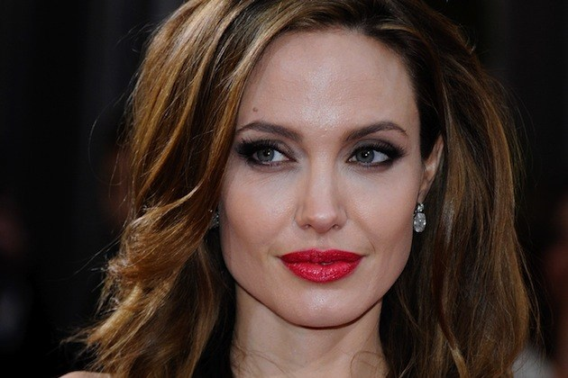
5. Angelina Jolie has a dagger collection
Angelina Jolie has demonstrated a fair number of quirks in her day (tattoos, blood vial necklaces), but motherhood has seemed to settle her down a little. Yet some of her wild flair still comes through with her collection of vintage and decorative knives. Her son Maddox even has a few, but apparently the blades on his daggers are dulled down. Every mother knows safety comes first.

Slide 14
Thanks For Attention
www.interactive-english.ru

