Slide 1
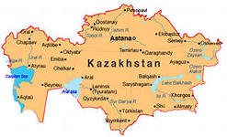
Going to Kazakhstan

Slide 2
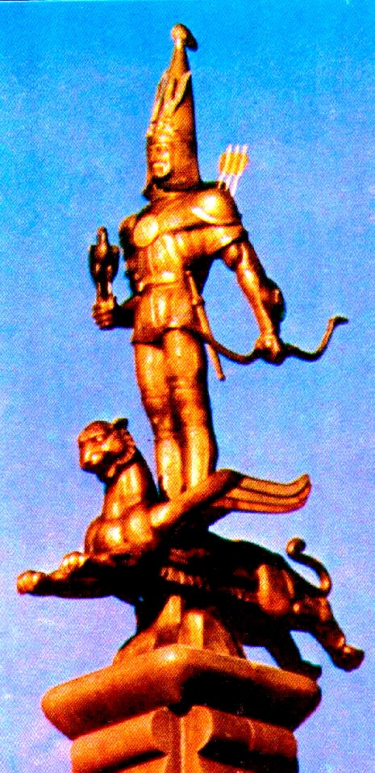
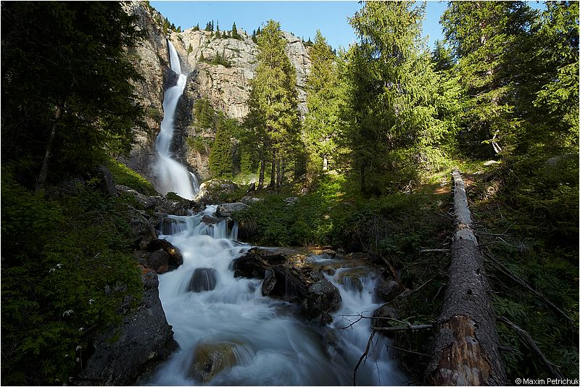
Kazakhstan-land, rich in its history, customs and traditions.
Kazakhstan is the Majesty of enormous mountain peaks, wild forests, deserts, huge heat rocks, diamond Lakes, boundless steppes, fast-flowing rivers, Stange power of glaciers in sunlight, unique fauna and flora.

Slide 3
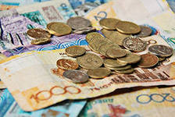
Money in Kazakhstan
tenge

Slide 4
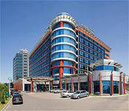
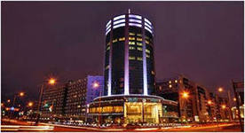
Where to stay?
Holiday In Аlmaty
and
Hotel Diplomat & Business Center
in Astana
pleasant stay

Slide 5
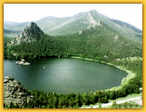
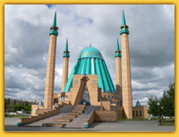
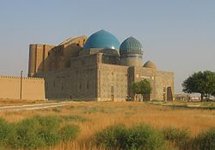
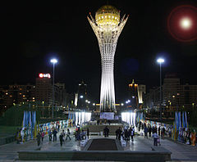
You can visit …
Burabai - "Kazakhstan Switzerland", "pearl of Kazakhstan"
The mosque named Mashhura Zhusup.
In pavlodar
Mausoleum of Khoja Ahmed Yasawi
In Turkestan
Bayterek is a monument in Astana

Slide 6
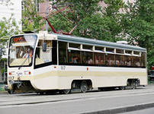
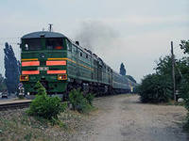
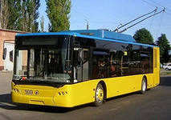
Getting around …
in Kazakhstan ride trams, trains, trolleybus.

Slide 7
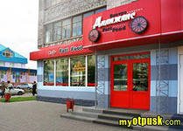
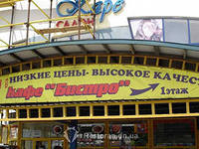
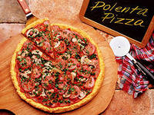
Eating out …..
better to eat at the pizzeria and cafe bistro
… because it is tasty and cheap.

Slide 8
The End !

